Slide 1

Sales Comparisons by Region

Slide 2

Objectives
Create a dashboard to visualize the sales comparison between two selected regions

Slide 3

Problem Statement
The director of a leading organization wants to compare the sales between two regions. He has asked each region operators to record the sales data to compare by region. The upper management wants to visualize the sales data using a dashboard to understand the performance between them and suggest the necessary improvements.

Slide 4
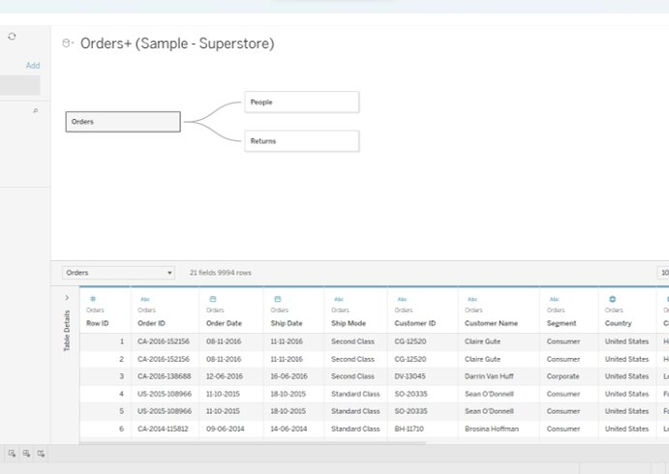
Select Sample Superstore as Dataset
Use Sample Superstore Dataset
Select Data

Slide 5
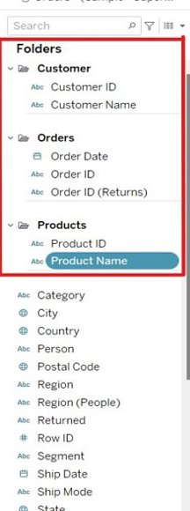
Select Sample Superstore as Dataset
Use Group by from Data Source Table on a Folder to create a folder to segregate the required data

Slide 6
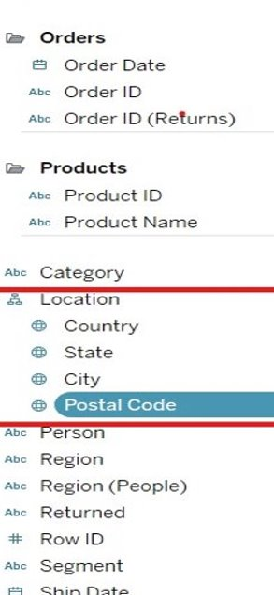
Create a hierarchy called Location

Slide 7
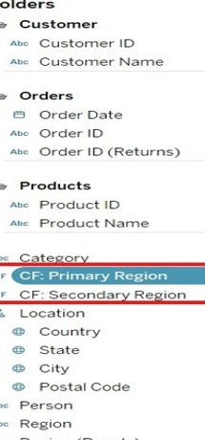
Create two parameters: Primary Region and Secondary Region with all regions listed in them.
Create Parameters for Primary Region and Secondary Region​
Create a Calculated Field for both Primary Region and Secondary Region

Slide 8
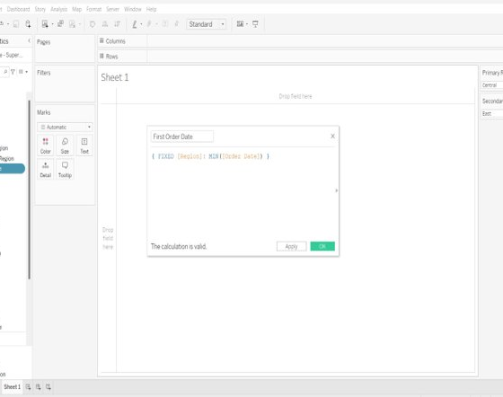
Create a First Order Date
Create a Calculated Field and name it as the First Order Date

Slide 9
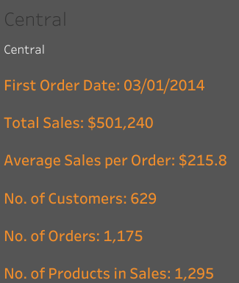
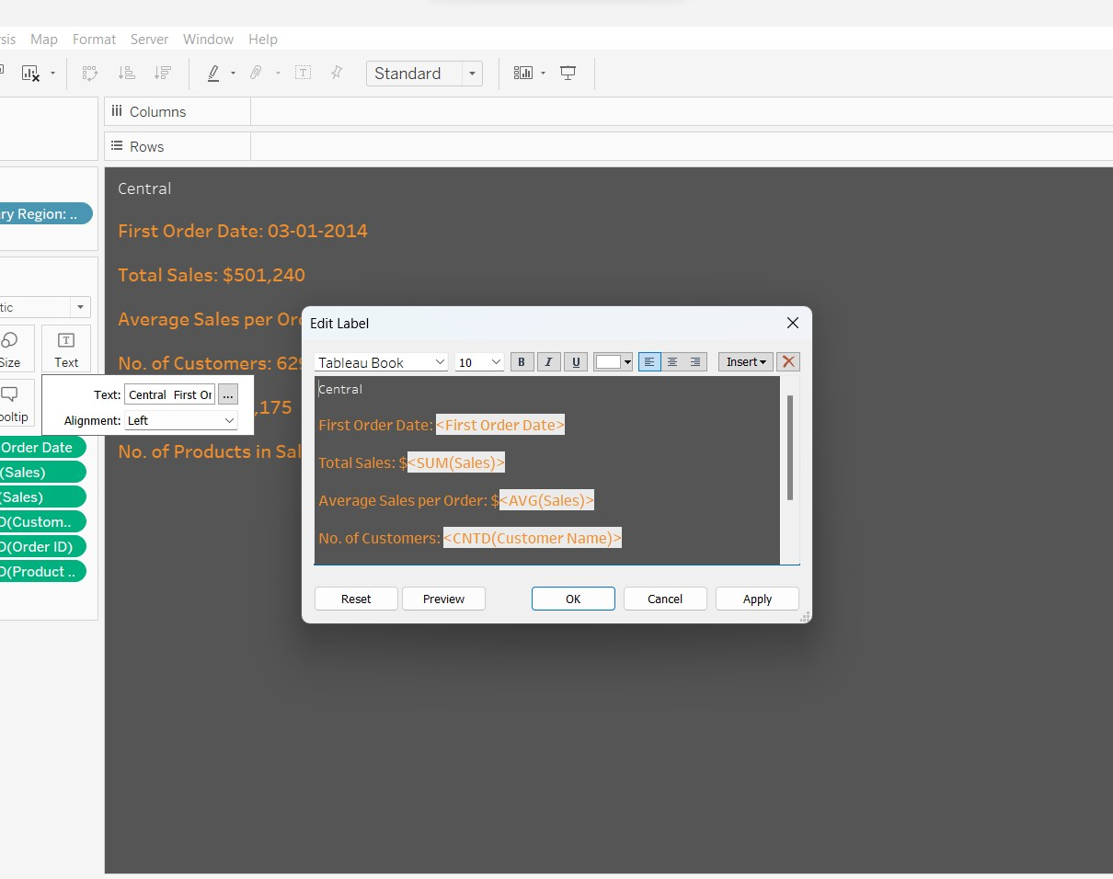
Displaying the below details of Primary Region
First Order Date
Total Sales
Average Sales per Order
No. of Customers
No. of Orders
No. of Products in Sale

Slide 10
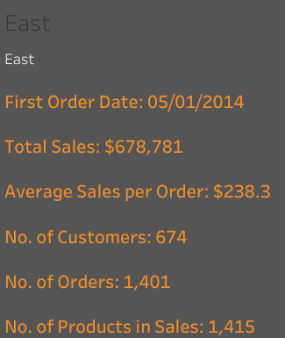

Displaying the below details of Secondary Region
First Order Date
Total Sales
Average Sales per Order
No. of Customers
No. of Orders
No. of Products in Sale

Slide 11
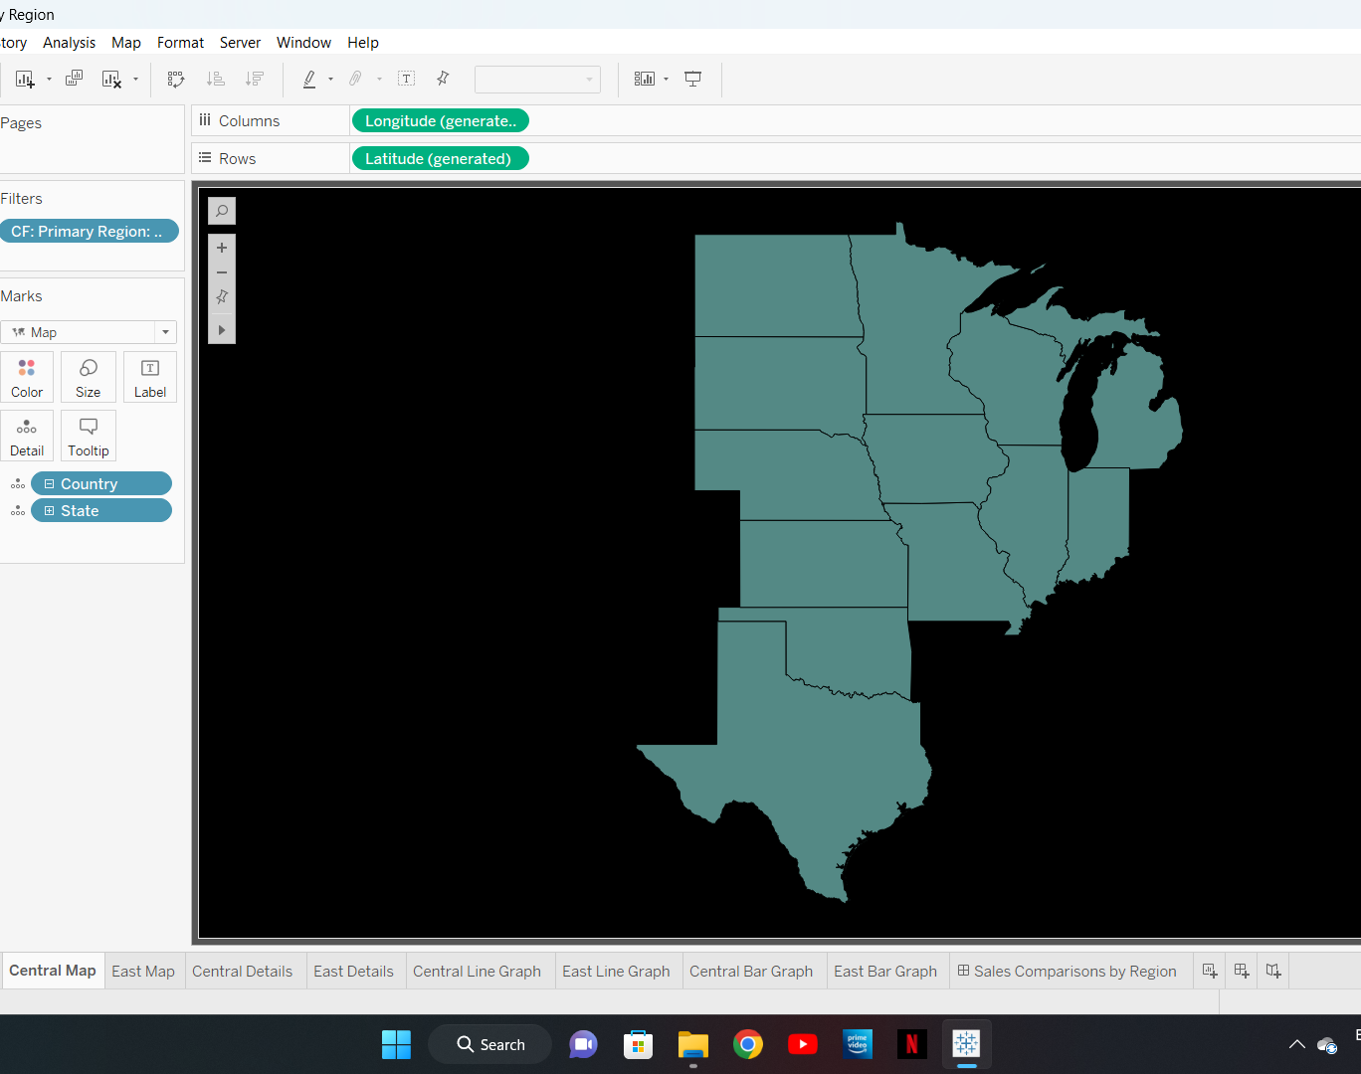
Central Map

Slide 12
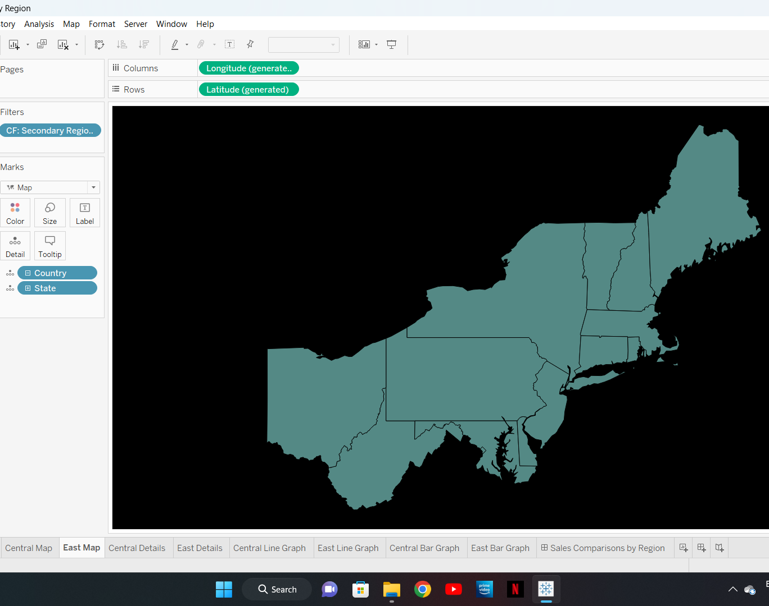
East Map

Slide 13
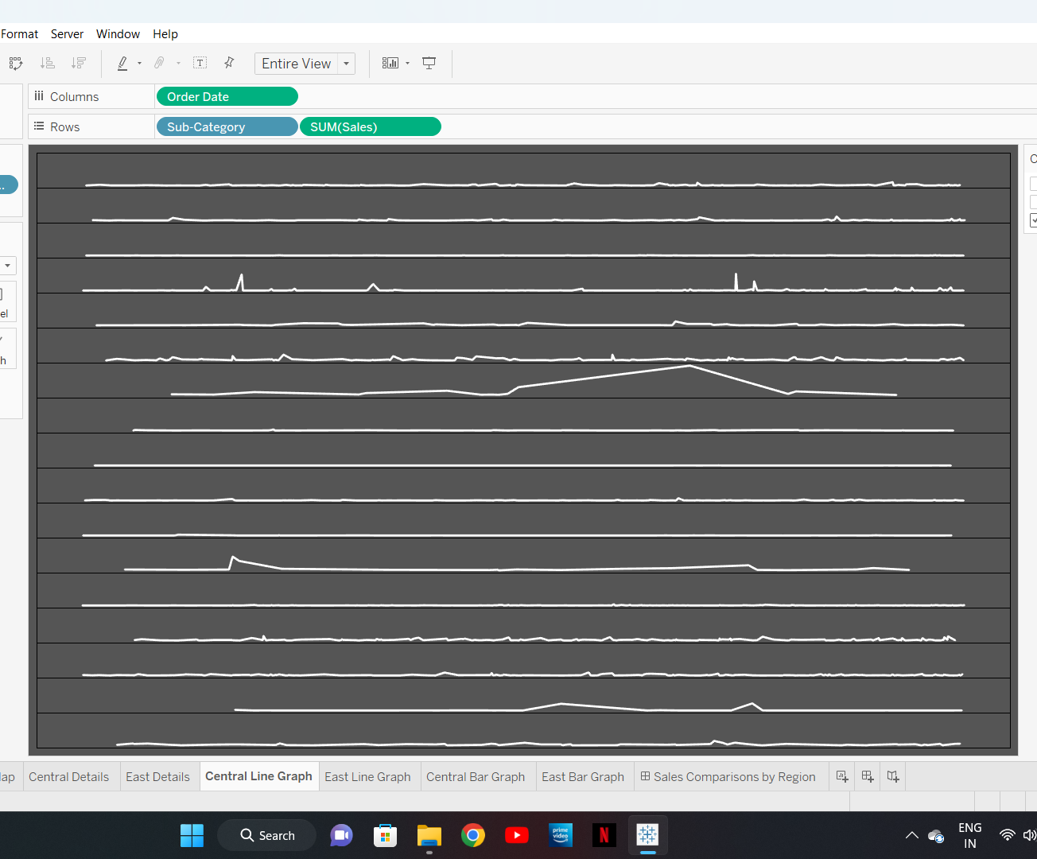
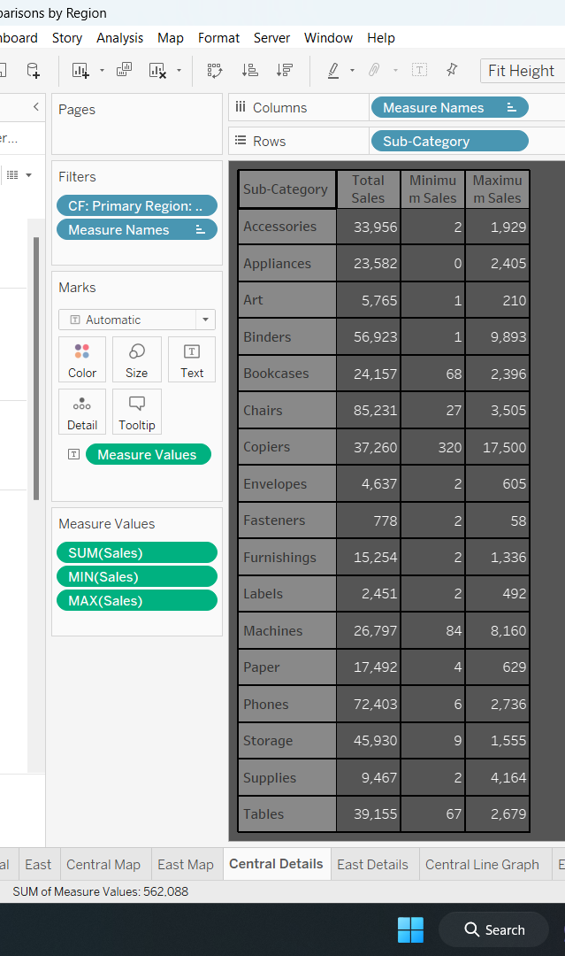
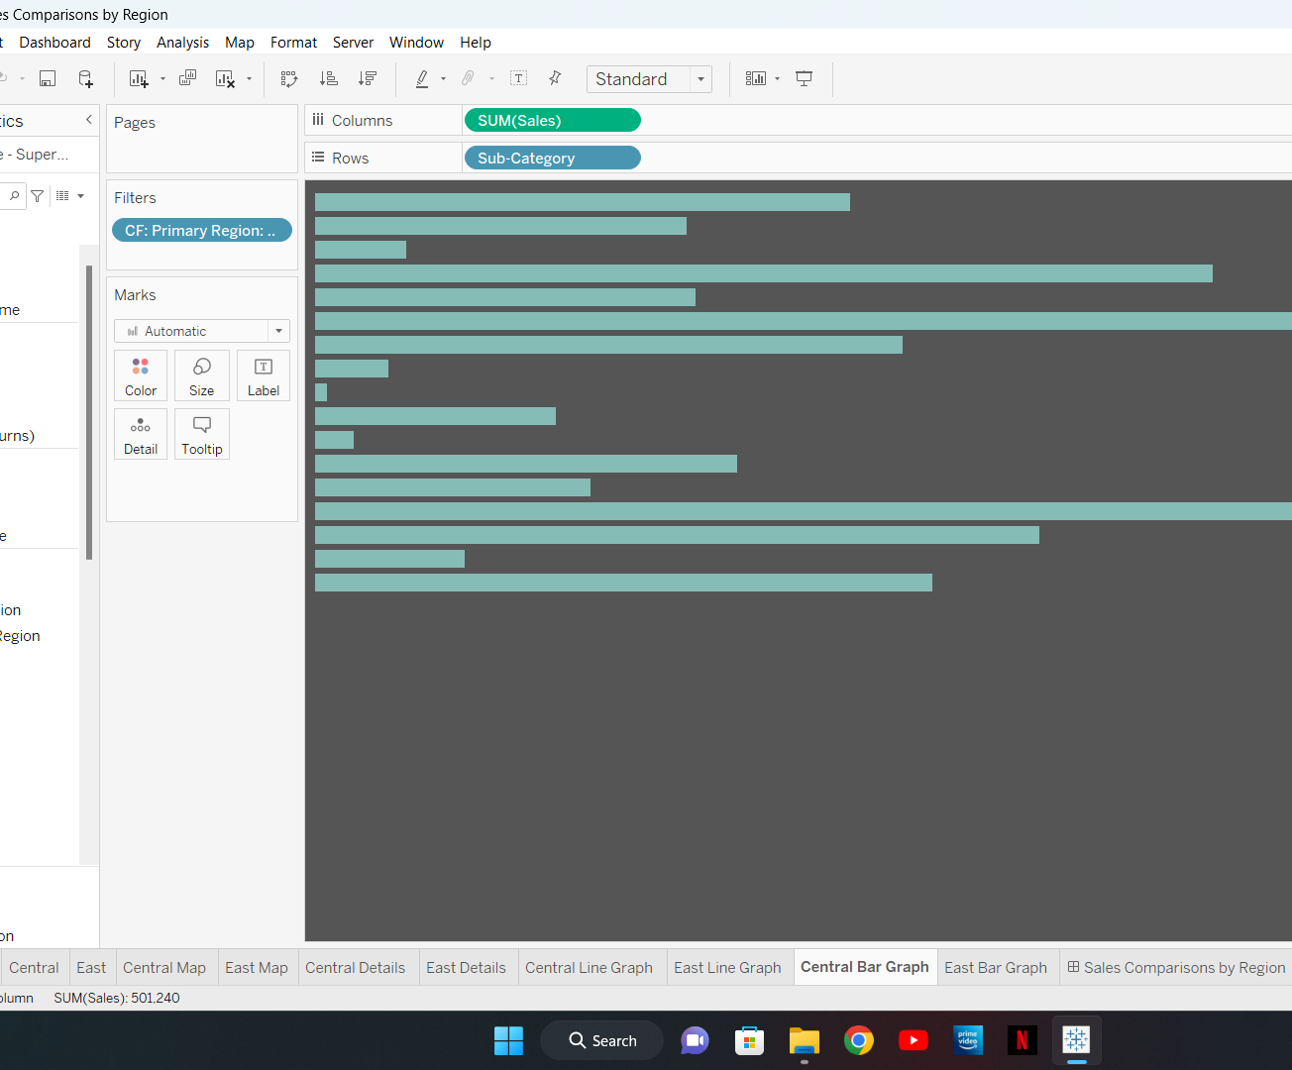
Central Details

Slide 14
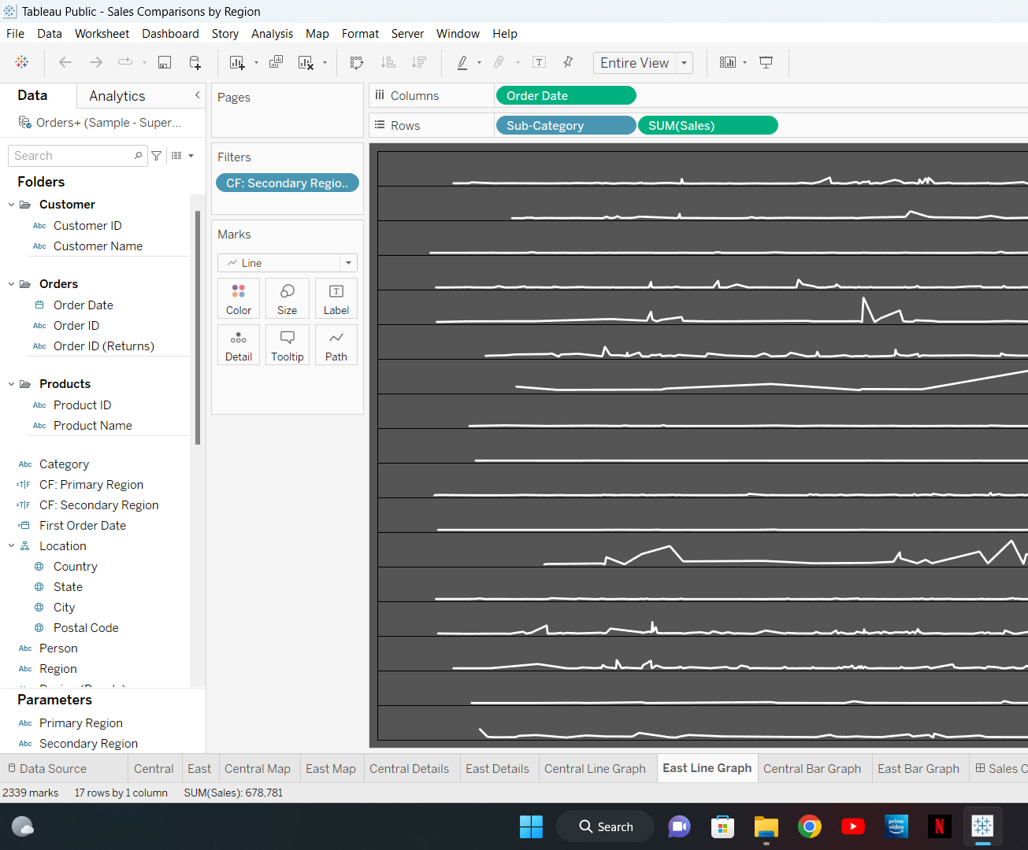

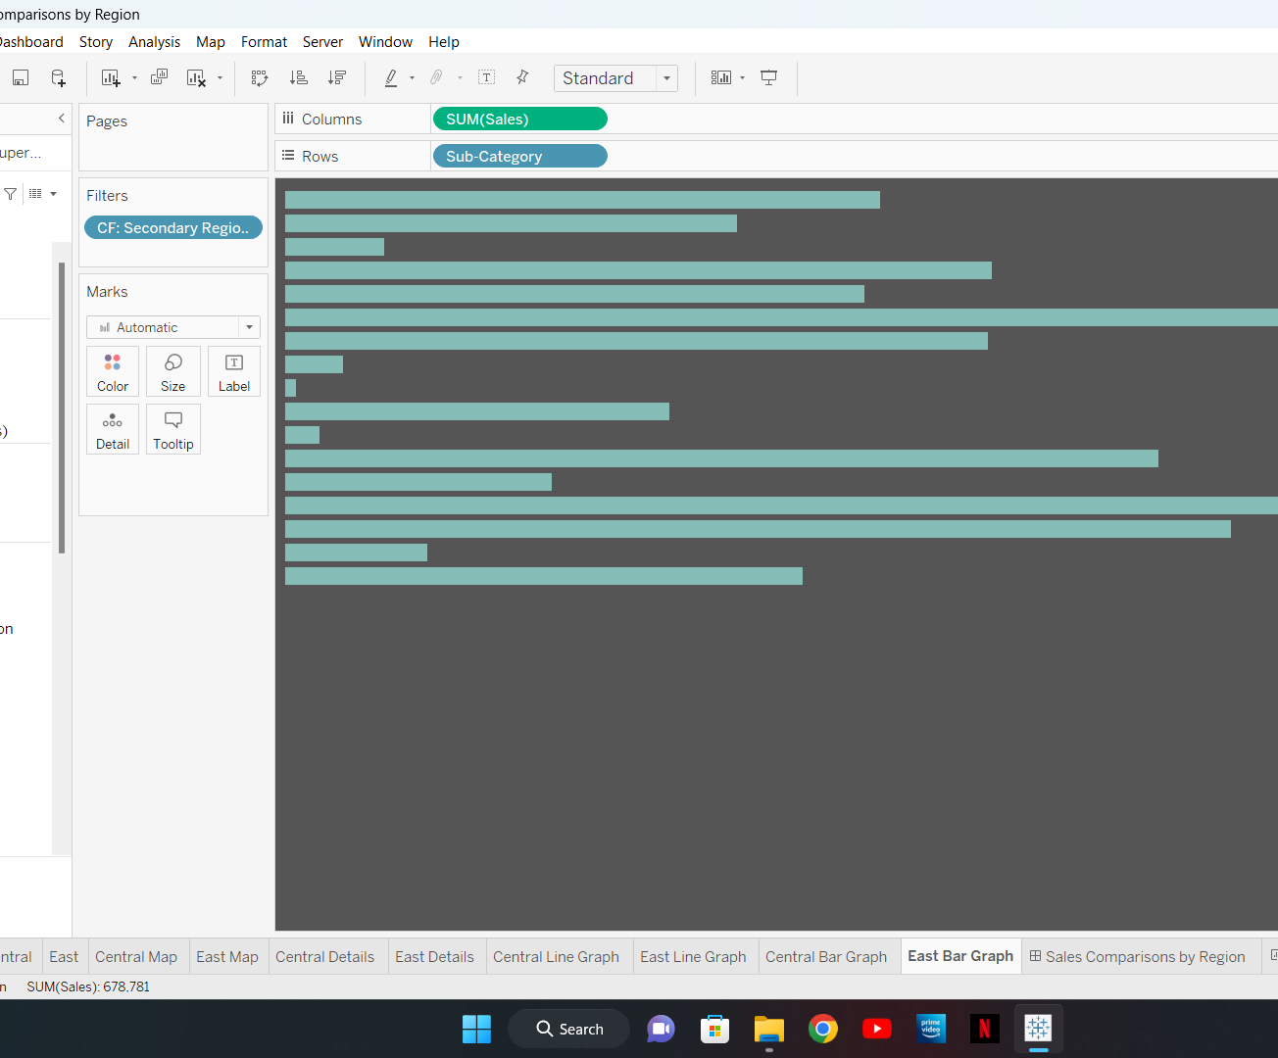
East Details

Slide 15
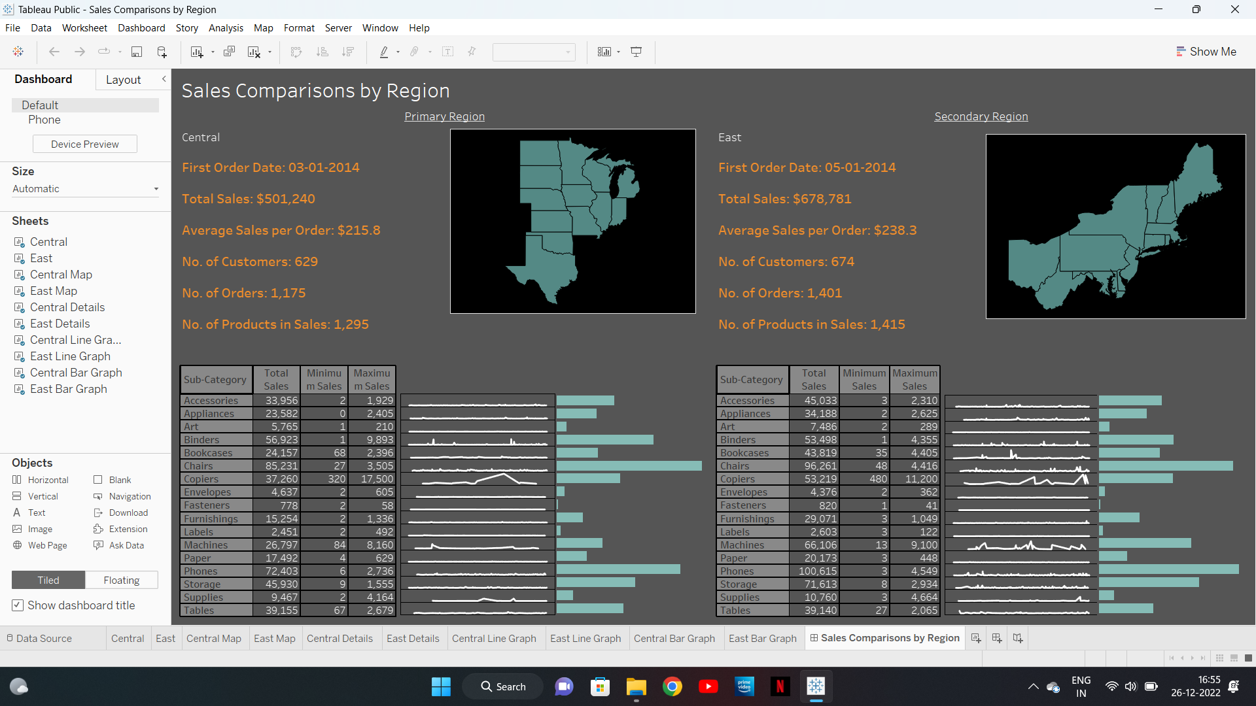
Sales Comparison by Primary and Secondary Region
Link:-
https://public.tableau.com/views/SalesComparisonsbyRegion_16719673301970/SalesComparisonsbyRegion?:language=en-GB&:display_count=n&:origin=viz_share_link

Slide 16
Project Outcome
This project is designed to help create a dashboard to visualize the sales comparison between two selected regions.
In order to increase sales, the organization can take preventive measures using dashboards.

Slide 17

Thank You!!

